Slide 1


Data Structures and Algorithms
Episode One:
Review on C++ concepts and OOP
Authors: Monier Ashraf & Ahmed Khaled

Slide 2

Know Your TA

Slide 3
Grading Scheme
Grade Distribution
Labs & Attendance/Participation: 10%
2 Practical Quizzes 10%
2 Assignments (individual) 15%
1 Project (group-based): 15%
Midterm: 20%
Final: 30%

Slide 4
Labs & Attendance/Participation
Quiz: At the start of every lab, you will have a 15-minute quiz to assess your understanding of the concepts covered in the previous class. If you miss the quiz, there will be no make-up opportunity. Arriving late will reduce your quiz time or potentially result in missing it altogether.
Lab:
During the lab, you will be given two questions:
The first question is a practice exercise to help you apply what you’ve learned.
The second question is your main lab task, which you will work on solving.
Attendance in the lab is mandatory and graded. The quiz counts for 80% and attendance and participation in answering questions during the theoretical part of the lab count for 20% of the lab grade..
Grade Inquiries:
If you have any concerns about your grades, please discuss them with your TA. You have up to two weeks from the release of grades to raise any issues. After that, grade reviews will not be accepted.
Your grades will be transparent, and no week will pass without updating your contribution marks. You can check your grades on Moodle.
Questions & Office Hours:
If you have questions during the lab or about the material, feel free to ask during office hours. We are more than happy to assist you!
Given That … we still wish you All the Best and Enjoy This Journey with Us

Slide 5
References
Adam Drozdek, Data Structures and Algorithms in C++, 4th edition, Cengage Learning.
Bjarne Stroustrup , The C++ Programming Language, Addison-Wesley.
H. M. Deitel and D. J. Deitel, C: How to Program, Pearson Education (for C++ review lectures).
Clifford A. Shaffer, Data Structures & Algorithm Analysis in C++, Dover Publications, 2013.

Slide 6
Tools
Visual Studio Code can following this demo https://code.visualstudio.com/docs/cpp/config-mingw
Clion
Visual Studio IDE
Can use any online IDE

Slide 7
Material & Code Files
Everything you’ll see are There on This Github Repo.
Updated Regularly.

Slide 8
Agenda
C++ Quick Review [30 mins]
Input/Output, Variables, Conditionals, Loops, Arrays, Functions, Pointers, and Structs.
OOP Introduction [30 mins]
Class, Constructor(s), Destructor, Attributes (Private & Public), Methods (Getters & Setters), Function Overloading
Hands-on [30 min]

Slide 9
C++ Programming Language Review

Slide 10
Let’s Show Not Tell
Standard Input & Output - Two Thirds of Computing Workflow
Variables and Data Types - Flexibility and Dynamic Processing
Conditionals - Branching and make Decision
Loops and Arrays - Handle Collections of Data
Functions - Program Modularity, being Composable
Pointers - Close Memory Management and Dynamic Memory Allocation
Structs - Compound Data Types [Having Parts]

Slide 11
Object-Orientation using C++

Slide 12
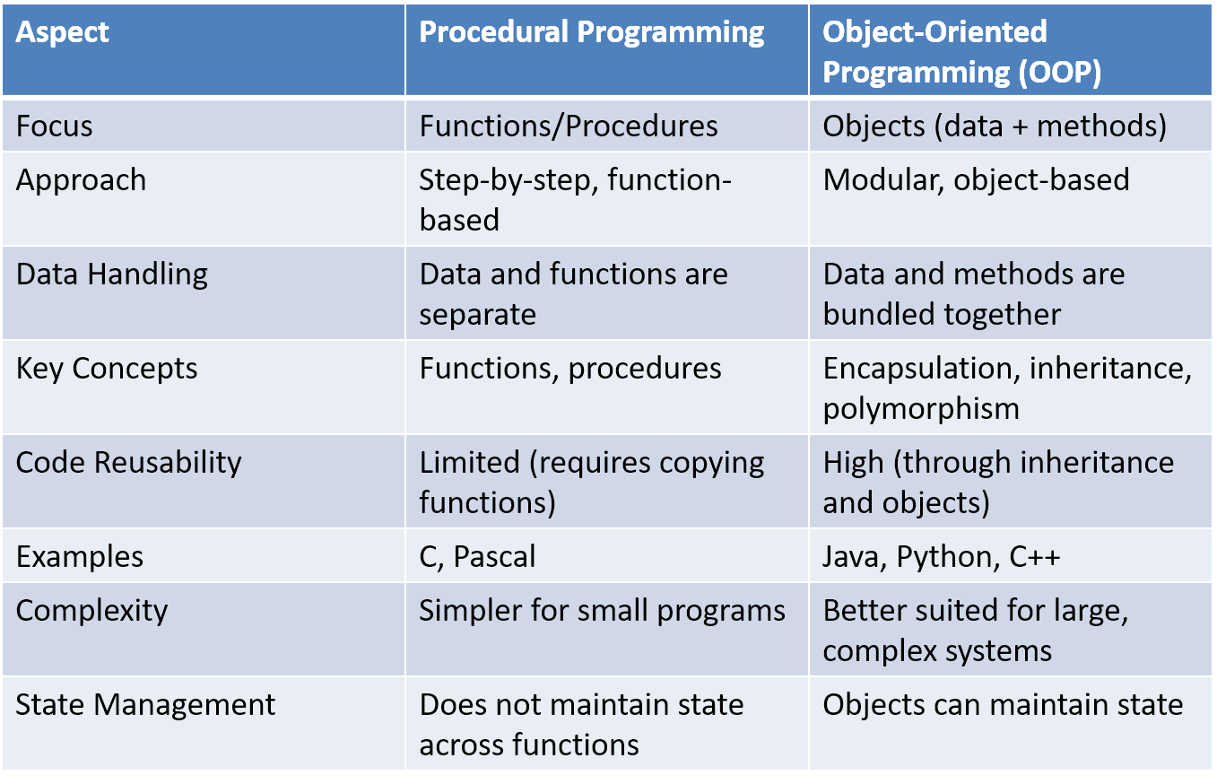
Procedural programming vs Object-oriented programming (OOP)

Slide 13
Class: A blueprint or template for creating objects. It defines properties (attributes) and behaviors (methods) that the objects will have. Object: An instance of a class. It contains real values for the properties and methods defined by the class
Class and Object

Slide 14
Access Modifier
Public:
Can be accessed outside the class directly.
The public members define the class interface
Private:
Accessible only to member functions of class
Private members and methods are for internal use only

Slide 15
Object Oriented Programming
is a way of solving complex problems by breaking them into smaller problems using objects.
OOP Design Principles:-
Encapsulation
Polymorphism
Inheritance
Abstraction [ Information Hiding ]

Slide 16
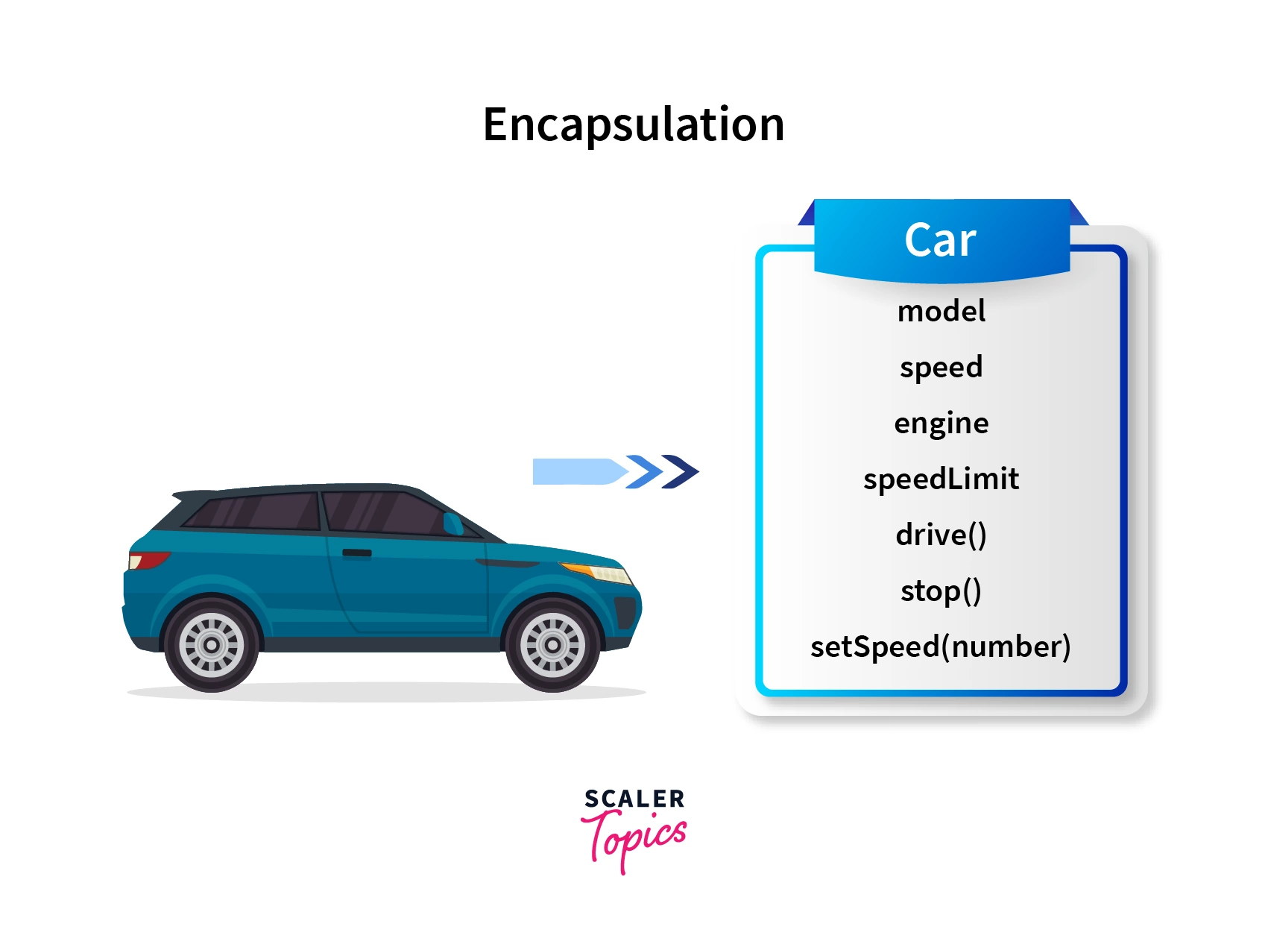
Encapsulation (Abstraction ) (Code modularity)
binding together the data and the functions that manipulates them
Then, objects that can interact with each other.
Let’s Code a Car Class with:-
speed and model Attributes
Two Constructor, One Default and One Parametrized Setters and Getters
Destructor
One Overloaded Member Function, How much Time, if it went x miles ?

Slide 17
Constructor
Constructor is a special member function of a class that initializes the object of the class.
Constructor name is same as class name, and it doesn’t have a return type.

Slide 18
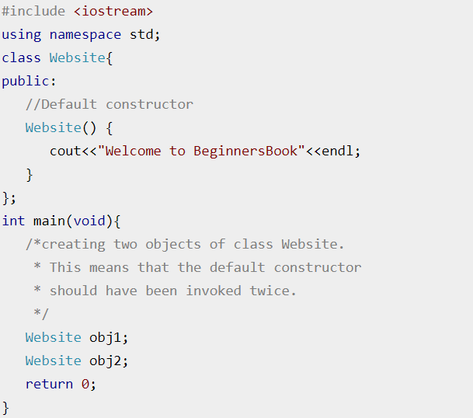
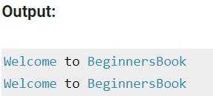
Types of Constructor in C++
1. Default Constructor:
Doesn’t have any arguments (or parameters).

Slide 19
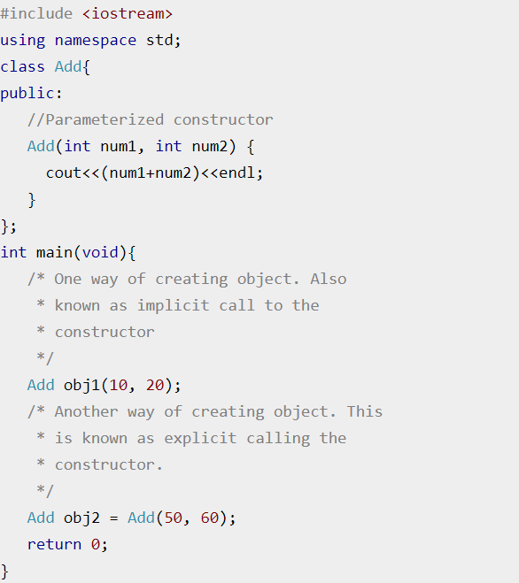
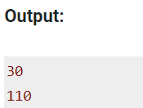
Types of Constructor in C++
2. Parameterized Constructor:
These type of constructor allows us to pass arguments while object creation.

Slide 20
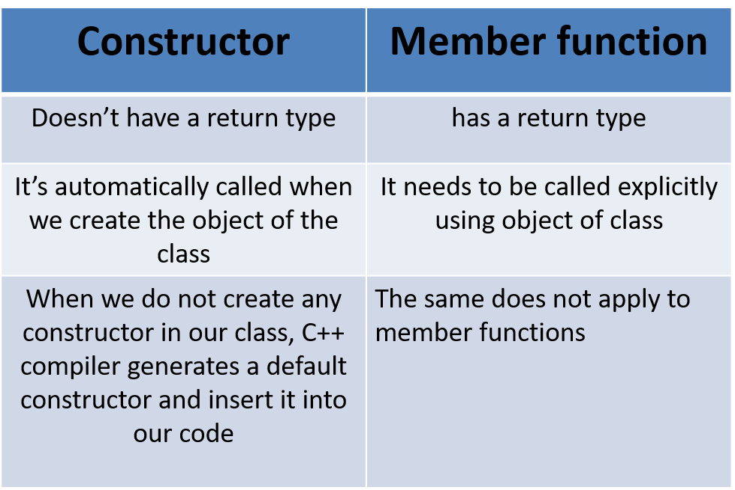
Difference between Constructor and Member function

Slide 21
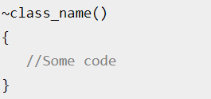
Destructor
A destructor is a special member function that works just opposite to constructor, unlike constructors that are used for initializing an object, destructors destroy (or delete) the object.
Syntax of Destructor:

Slide 22
Destructor Rules:
Name should begin with tilde sign(~) and must match class name.
There cannot be more than one destructor in a class.
Unlike constructors that can have parameters, destructors do not allow any parameter.
They do not have any return type, just like constructors.
When you do not specify any destructor in a class, compiler generates a default destructor and inserts it into your code.

Slide 23
Polymorphism (Code Reuse)
is a powerful concept in OOP and allows for more flexible and extensible code by promoting code reuse and reducing the amount of duplicate code required.
Will Shine on Inheritance. Next Time.

Slide 24
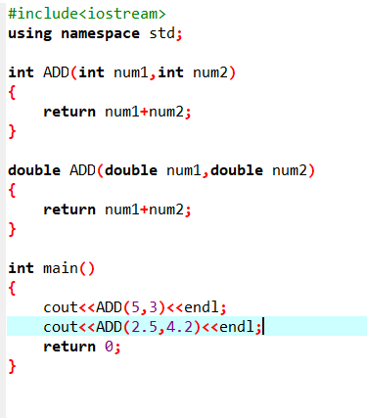
Function Overloading
Functions with same name and different parameters
Overloaded functions should perform similar tasks

Slide 25
Key Concepts (Car Example)
Encapsulation: Keeping the data (speed and model) private and accessing them through public methods.
Polymorphism: Demonstrated by overloading the calculateTime function to handle both integer and double types.
Constructors and Destructor: Used to initialize and clean up objects.

Slide 26
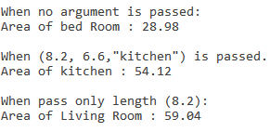
Hands-On
Write a program to handle Rooms of any apartment by creating Room Class.
Member variables: Length, breadth, room_name.
Make three constructors:
Default: length = 6.9, breadth = 4.2, room_name = “bed Room”.
Parameterized: by passing (Length, breadth, room_name) to member variables.
Constructor with passing one argument (Length) and fixed breadth = 7.2 and room_name = “Living Room”.
Apply Encapsulation by using Setters and getters.
Calculate Area of the Room.
Create 3 objects to apply every constructor type.

Slide 27

Thank You!

Slide 28
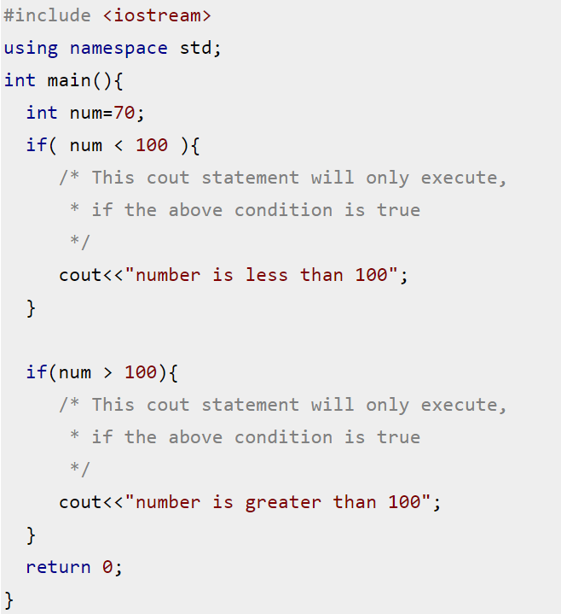
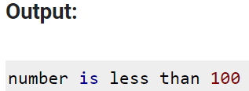
Revision – C++
If else:

Slide 29
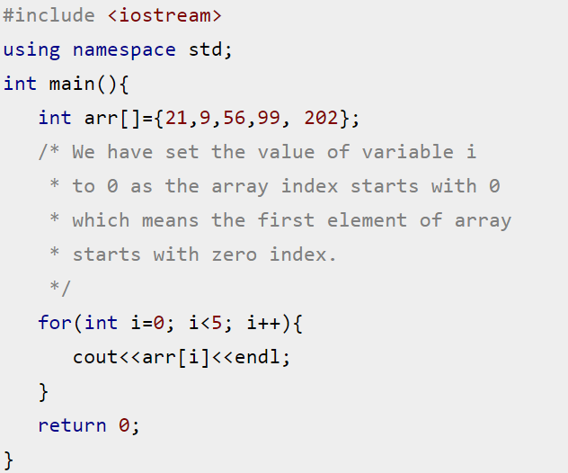
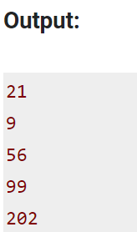
Revision – C++
For loop:

Slide 30
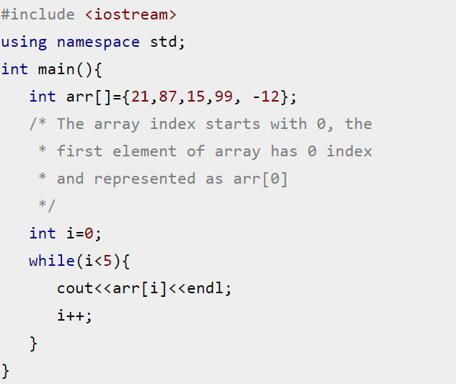
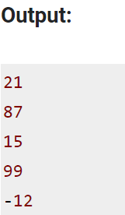
Revision – C++
While loop:

Slide 31
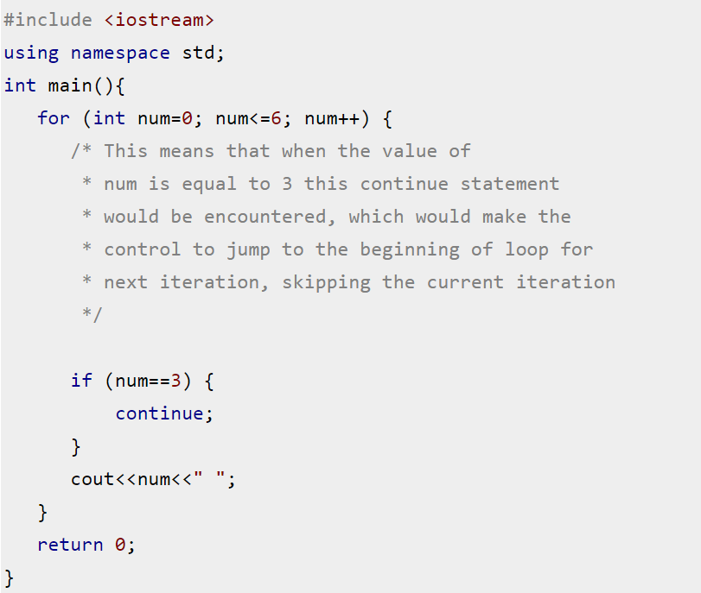
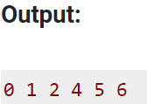
Revision – C++
Continue:

Slide 32
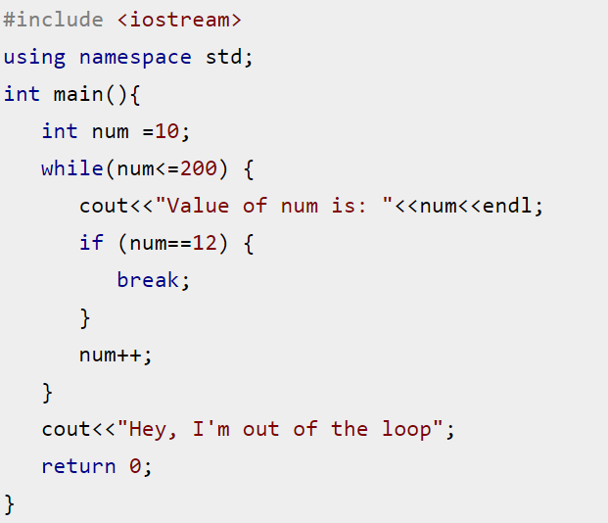
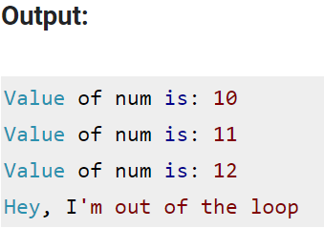
Revision – C++
Break:

Slide 33
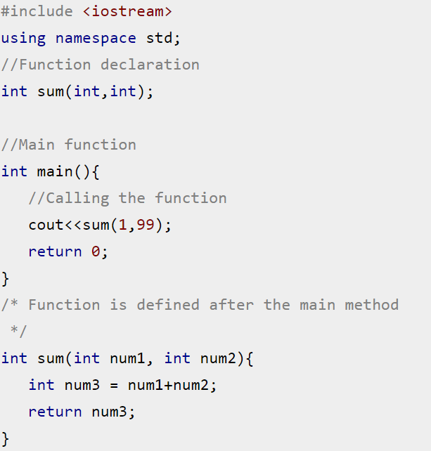
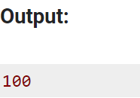
Revision – C++
Function:

Slide 34
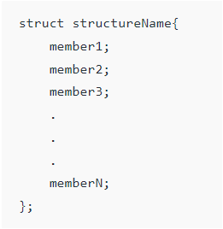
Revision – C++
Structure: A structure is a user-defined data type in C++. A structure creates a data type that can be used to group items of possibly different types into a single type.

Slide 35
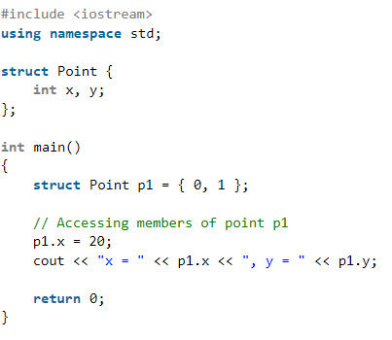
Revision – C++
Structure: A structure is a user-defined data type in C++. A structure creates a data type that can be used to group items of possibly different types into a single type.

Slide 36
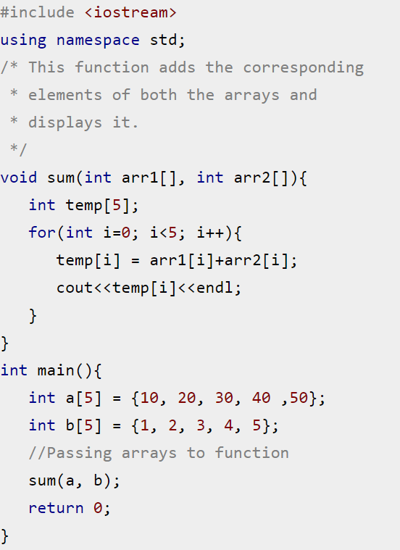
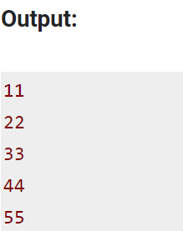
Revision – C++
Passing Array to function:

Slide 37
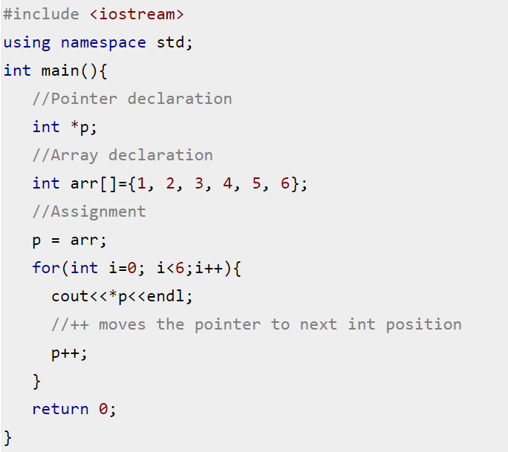
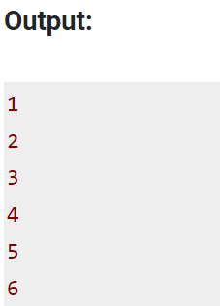
Revision – C++
Pointers:

Slide 38
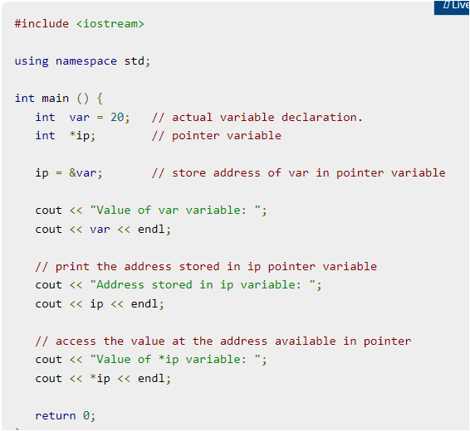

Revision – C++
Pointers:
Output

Slide 39
C++ OOPs

Slide 40
Revision – C++ class and objects
Object oriented programming is a way of solving complex problems by breaking them into smaller problems using objects.
The OOP is all about creating objects that can interact with each other, this makes it easier to develop programs in OOP as we can understand the relationship between them.

Slide 41
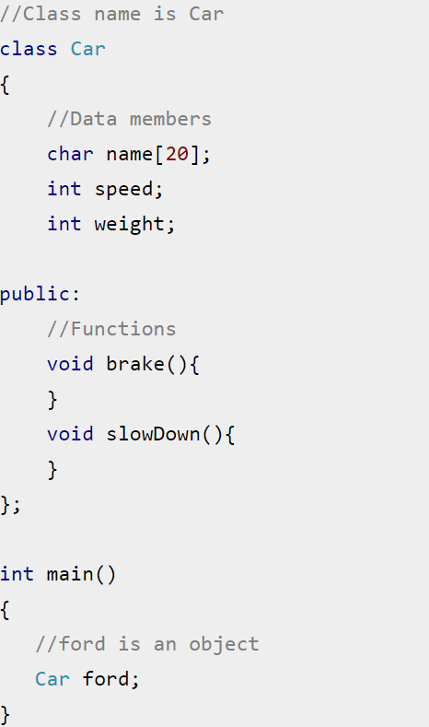
Revision – C++ class and objects
Example:

Slide 42
Summary of OOP
Object-Oriented Programming (OOP) Concepts
Encapsulation
Polymorphism
Inheritance
Information
hiding
Function
overriding
Different ways to inherit classes from other classes
Classes and objects
Constructor
and destructor
Function
overloading
Function
overriding
Access specifier
Getter and setter

Slide 43
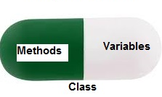
Encapsulation
Encapsulation is defined as binding together the data and the functions that manipulates them.
A class is like a blueprint of data member and functions and object is an instance of class.

Slide 44
Constructor
Constructor is a special member function of a class that initializes the object of the class.
Constructor name is same as class name, and it doesn’t have a return type.

Slide 45
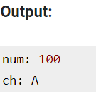
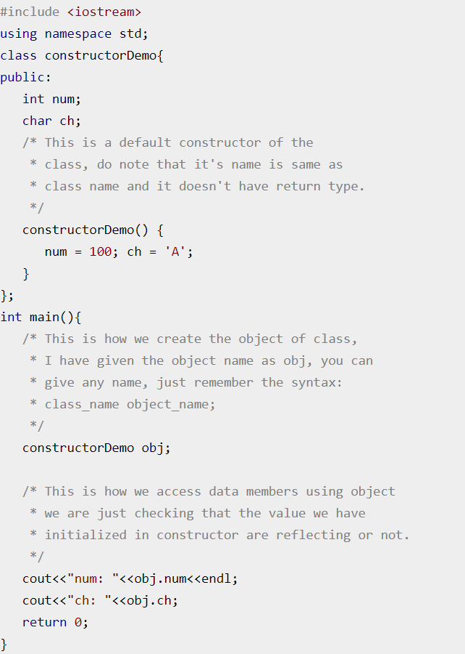
Example:

Slide 46
Difference between Constructor and Member function

Slide 47
Types of Constructor in C++
1. Default Constructor:
Doesn’t have any arguments (or parameters).

Slide 48
Types of Constructor in C++
2. Parameterized Constructor:
These type of constructor allows us to pass arguments while object creation.

Slide 49
Destructor
A destructor is a special member function that works just opposite to constructor, unlike constructors that are used for initializing an object, destructors destroy (or delete) the object.
Syntax of Destructor:

Slide 50
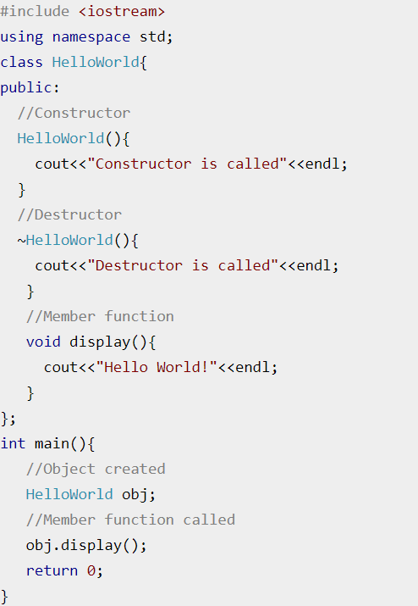
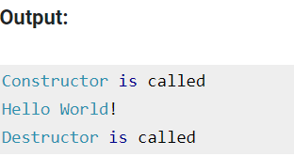
Example:

Slide 51
Destructor Rules:
Name should begin with tilde sign(~) and must match class name.
There cannot be more than one destructor in a class.
Unlike constructors that can have parameters, destructors do not allow any parameter.
They do not have any return type, just like constructors.
When you do not specify any destructor in a class, compiler generates a default destructor and inserts it into your code.

Slide 52
Summary of OOP
Object-Oriented Programming (OOP) Concepts
Encapsulation
Polymorphism
Inheritance
Information
hiding
Function
overriding
Different ways to inherit classes from other classes
Classes and objects
Constructor
and destructor
Function
overloading
Function
overriding
Access specifier
Getter and setter

Slide 53
Polymorphism
Polymorphism is a powerful concept in OOP and allows for more flexible and extensible code by promoting code reuse and reducing the amount of duplicate code required.

Slide 54
Function Overloading
Functions with same name and different parameters
Overloaded functions should perform similar tasks

